Slide 1
TOSN Paper Summary
Steven Lai

Slide 2
Achieving Long-Term Surveillance in VigilNet
Main contributions:
A tripwire service partition the network into sections where each section can be scheduled independently.
A duty cycle scheduling for sentry nodes so that they can be turned on and off to save energy.

Slide 3
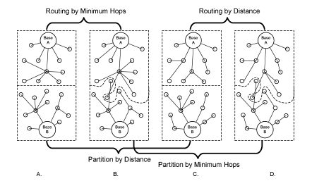
Tripwire Partition
Basic Idea: Using Voronoi diagram such that each section contains exactly one base I and every node in that section is closer to its base I than to any other base inside the sensor field

Slide 4
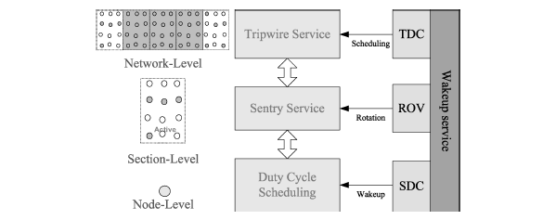
Sentry Service
Main idea: select only part of the nodes as sentry nodes which are responsible for surveillance

Slide 5
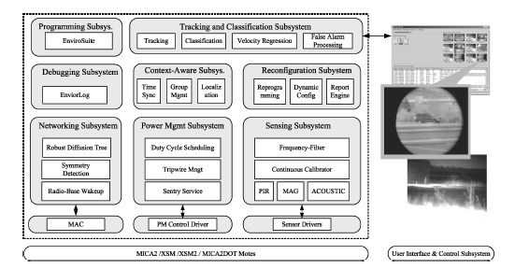
Implementation Details

Slide 6
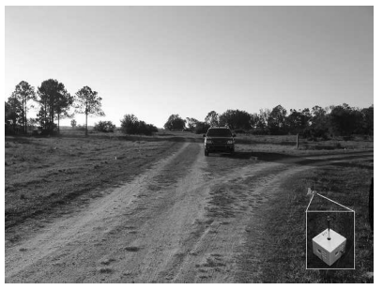
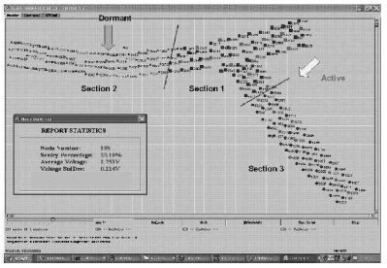
Real Deployment and Testing

Slide 7
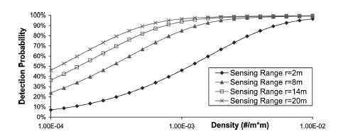
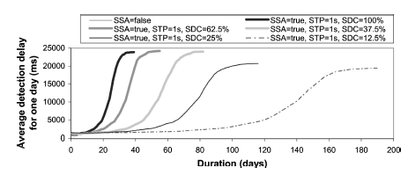
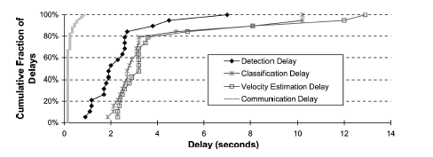
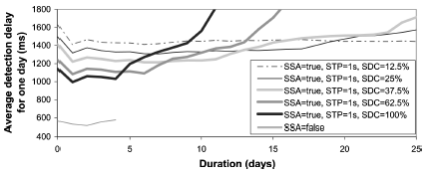
Results

Slide 8
BikeNet: A Mobile Sensing System for Cyclist Experience Mapping
Use MetroSense architecture
People-centric sensing
Opportunistic / delay-tolerant communication

Slide 9
BikeNet Goals
Cyclist performance measurement
Environment mapping
Long-term performance trend analysis
Data collection and local presentation
Data query and remote presentation
Disconnected operation

Slide 10
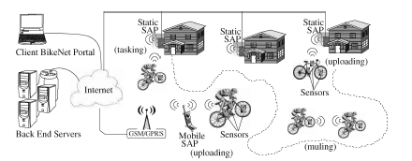
System Architecture

Slide 11
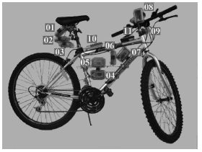
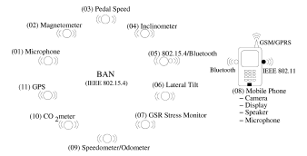
Implementation on the Bike

Slide 12
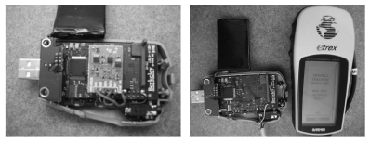
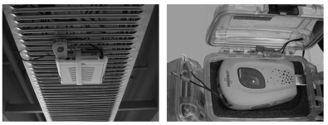
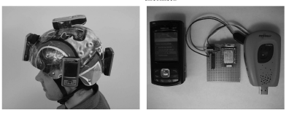
Implementation for Access Points

Slide 13
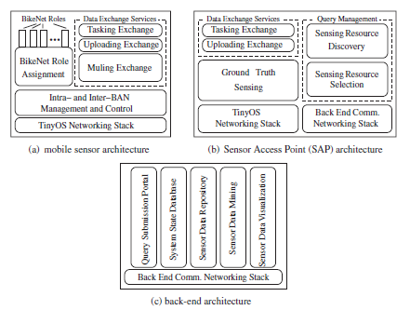
Software Architecture

Slide 14
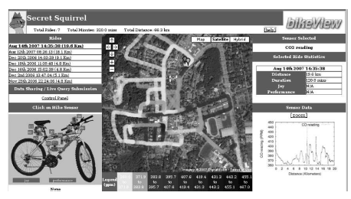
Interface Design

Slide 15
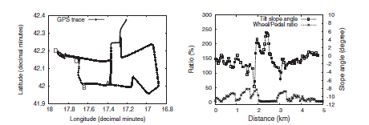
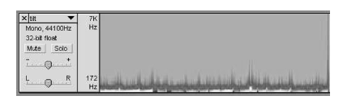
Evaluation

Slide 16
Design and Evaluation of a Hybrid Sensor Network for Cane Toad Monitoring
Application—monitoring amphibian populations in the monsoonal woodlands of northern Australia
Techniques:
Vocalizations recognition
Hybrid network

Slide 17
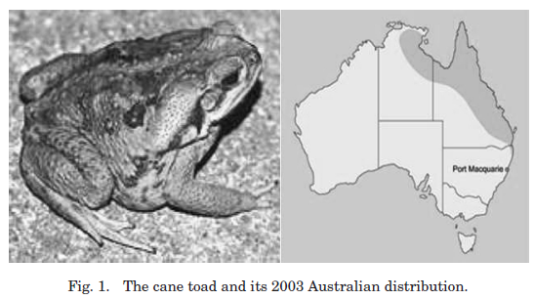
Background

Slide 18
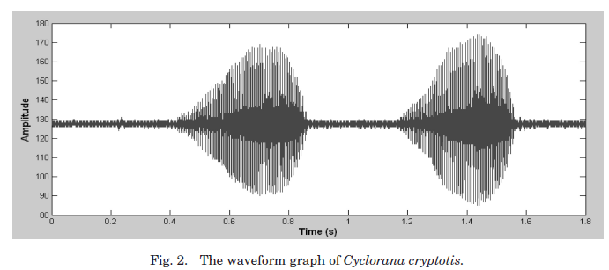
Background

Slide 19
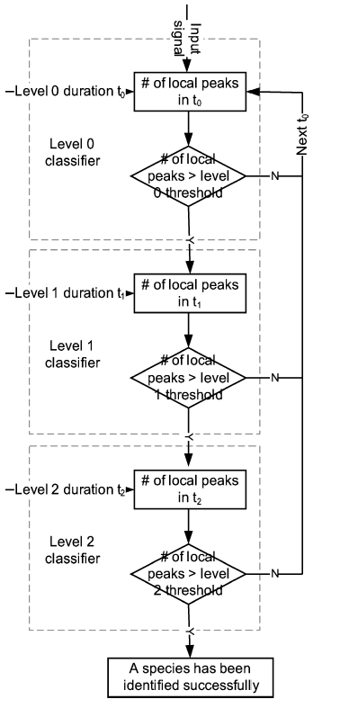
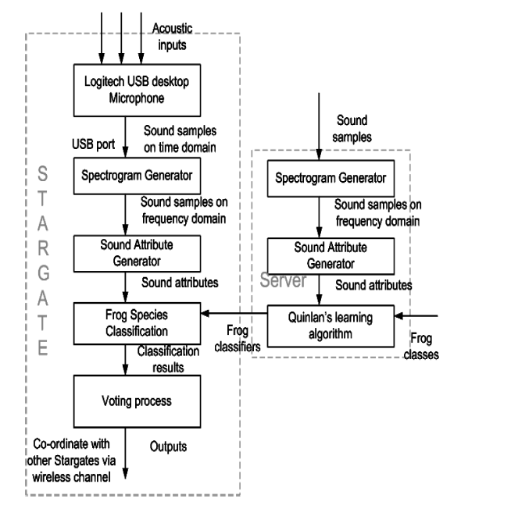
Flow Chart Design

Slide 20
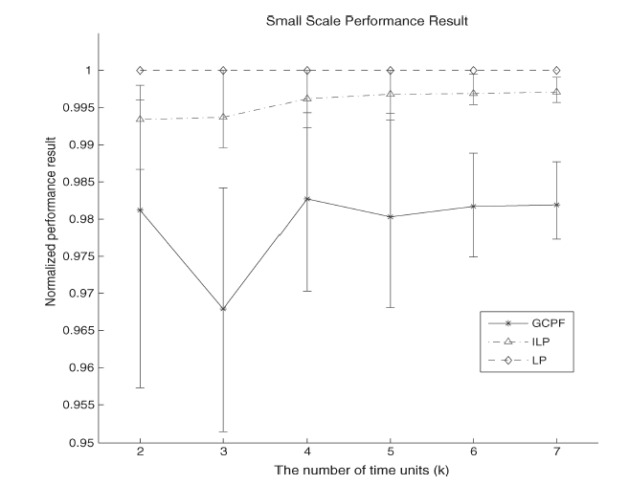
Evaluation

Slide 21
EnviroMic: A Storage-Centric Audio Sensor Network
Features:
For disconnected operation
Distributed acoustic monitoring, storage, trace and retrieve
Purpose:
Study animal populations in the wild

Slide 22
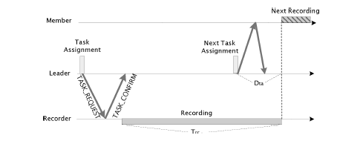
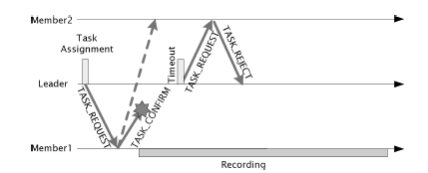
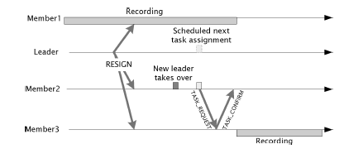
Task Assignment Scheme

Slide 23
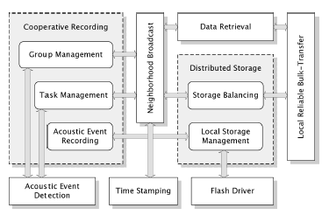
Software Architecture

Slide 24

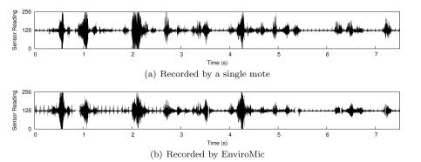
Packet Structure
Packet structure:
Sound wave

Slide 25
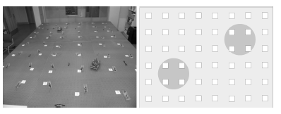
Indoor Testbed

Slide 26
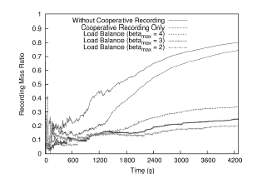
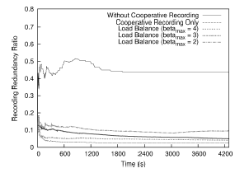
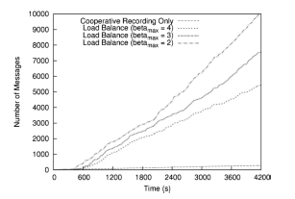
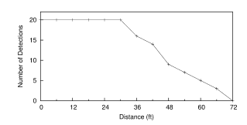
Evaluation

Slide 27
Trail: A Distance-Sensitive Sensor Network Service For Distributed Object Tracking
Motivation: distance-sensitive service for mobile objects in sensor network
Approach: grid-based

Slide 28
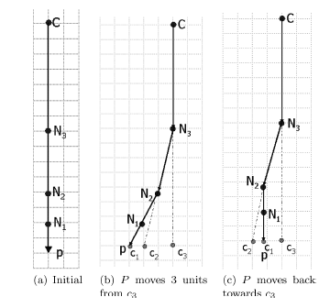
Examples of Trail of an Object

Slide 29
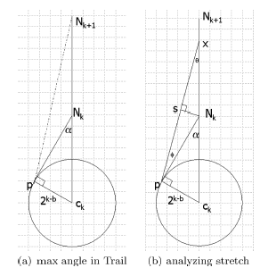
Analyze Parameters

Slide 30
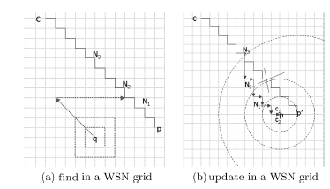
Algorithm for the Grid

Slide 31
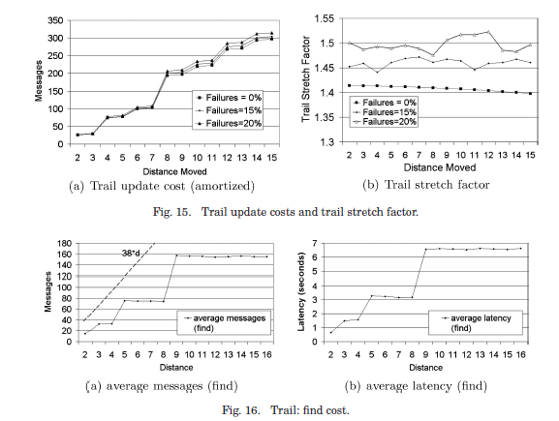
Evaluation

